Slide 1
Opp Project proposal
Sir usama bin Shakeel

Slide 2

Group Members
Syeda Maham batool
Murtaza khalid
Syed kifayat ur rahman

Slide 3
Mall management
Mall management system include all the operation and maintenance of entire building infrastructure which includes the management of accounts, shops, security and parking. IT IS IMPORTANT TO DEAL WITH MANAGEMENT IN THIS ERA .WE GUYS DECIDED TO MADE MALL MANAGEMENT SYSTEM SO THAT IT ALSO HELP US TO DEAL WITH DIFFIRENT SCENARIOS .WE COME TO KNOW THAT HOW TO ORGANIZE OUR CODE AND SUMMARIZE OUR CODE USING CLASSES.

Slide 4

Authorized persons
Head
Manager
Sub managers
Parking manager
Account manager
Maintenance manager
This Photo by Unknown Author is licensed under CC BY-SA-NC

Slide 5
head
Basically, head act as the owner of the mall and have access to see the data of entire employees working in the mall. Head have access to following:
Account’s information
Maintenance details
Employee details
Parking details

Slide 6
manager
Manager have access to edit or display the following data:
Account information
Maintenance details
Employee details
Parking details

Slide 7

Sub managers
Account manager
Electricity manager
Water manager
Security manager

Slide 8

Account manager
Account manager can manage the whole financial record of our mall.
Total revenue
Profit
Tax
Net amount
Employees salaries
Electricity, water and security budgets
Electricity bill
This Photo by Unknown Author is licensed under CC BY-SA

Slide 9

Electricity manager
Electricity provider
Backup provider
Budget
Connection point
Energy consumption
Electricity bill
This Photo by Unknown Author is licensed under CC BY

Slide 10
Water manager
Water consumption
Connection point
Company provider
Per-day consumption
Filter water
Pump capacity
Drinking water pointer

Slide 11
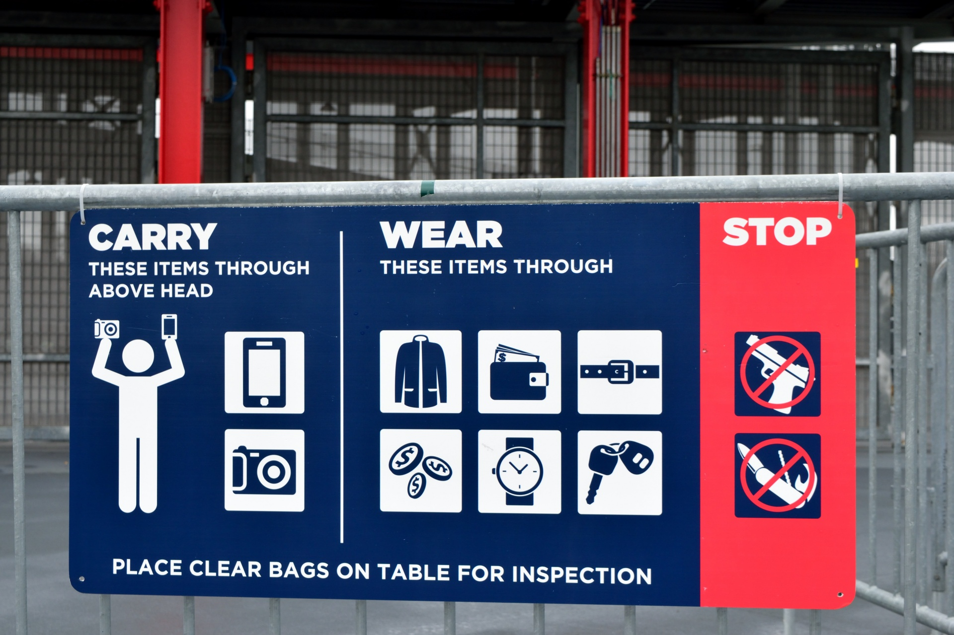
Security manager
Security camera’s
Control room location
Security equipment’s
escape room location
Security budget

Slide 12
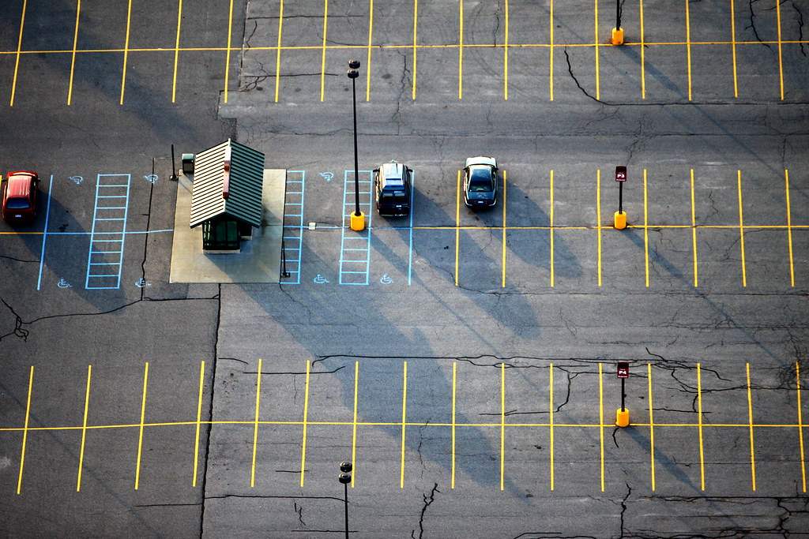
Parking manager
Vehicle type
Vehicle registration number
Arriving time
Departure time
This Photo by Unknown Author is licensed under CC BY-ND

Slide 13
TASK LIST
Syeda Maham Batool
SYED KIFAYAT UR RAHMAN
MURTAZA KHALId
Formation of desire classes according to program.
IMPORTANT DETAILS
SECURITY MANAGER
Formation of classes according to program
ACCOUNT MANAGER
WATER MANAGER
Formation of classes according to program
ELECTRICITY MANAGER
PARKING MANAGER

Slide 14
